Slide 1


SEND Information Report

Slide 2


Contents
What types of SEN does the school provide for?
Which staff will support my child, and what training have they had?
Specialist team
External Agencies
What should I do if I think my child has SEN?
How will the school know if my child needs SEN support?
Flowchart for Graduated Approach Step 1-2
Flowchart for Graduated Approach Step 3-4
Flowchart for Graduated Approach Step 5-6
Flowchart for Graduated Approach Step 7
Contents page 2
How will the school measure my child’s progress?
How will I be involved in decisions made about my child’s education?
How will my child be involved in decisions made about their education?
How will the school adapt its teaching for my child?
High Quality Teaching at Lingfield
Adaptive Teaching at Lingfield
Strategies
How will the school evaluate whether the support in place is helping my child?
How will the school resources be secured for my child?

Slide 3
Contents 2
Contents page 1
How will the school make sure my child is included in activities alongside pupils who don’t have SEND?
How does the school make sure the admissions process is fair for pupils with SEN or a disability?
How does the school support pupils with disabilities?
How will the school support my child’s mental health and emotional and social development?
What support will be available for my child as they transition between classes or settings or in preparing for adulthood?
What support is in place for looked-after and previously looked-after children with SEN?
What should I do if I have a complaint about my child’s SEN support?
What support is available for me and my family?
Glossary

Slide 4

What types of SEN does the school provide for?
We make reasonable adjustments to our practices so as to comply with the Equality Act (2010). We have trained staff in the following areas:
● 1:1 Reading
● THRIVE (promotes positive mental health and emotional wellbeing in children)
● Emotional Literacy (ELSA)
● Read Write Inc. Intervention
● White Rose Maths Intervention
● Read Write Inc. Comprehension Intervention
● Speech and Language
● Occupational Therapy
● Early Talk Boost
● Autism training from Woodlands and Carew Academy
● Behaviour and de-escalation strategies (See Behaviour Policy)
Regular, on-going professional development in identified areas where staff need additional training is part of our school’s culture.
We are a two-form entry, mainstream, inclusive school that fully complies with the requirements outlined in the Special Educational Needs Code of Practice (2014). Staff have been trained so they are able to cater for children who may have difficulties with:
● Cognition and Learning
● Communication and Interaction
● Social, Emotional and Mental Health
● Sensory and/or Physical

Slide 5

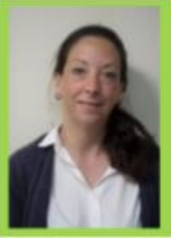
Which staff will support my child, and what training have they had?
Our special educational needs co-ordinator, or SENCO
Our SENCO is Natalie Hadleigh she can be contacted by email: nhadleigh@lingfield.surrey.sch.uk or by phone: 01342 832626
Natalie has 5 years experience in this role and is a member of the Leadership Team. She has been a qualified teacher for over 20 years. Natalie achieved the National Award in Special Educational Needs Co-ordination in 2021 and attends regular CPD on SEN, leadership and inclusion.
SENCO Admin Assistant
Our SENCo Admin Assistant is Tor Waite. She organises SEND paperwork, books meetings and arranges diary visits with outside agencies and parents.

Slide 6
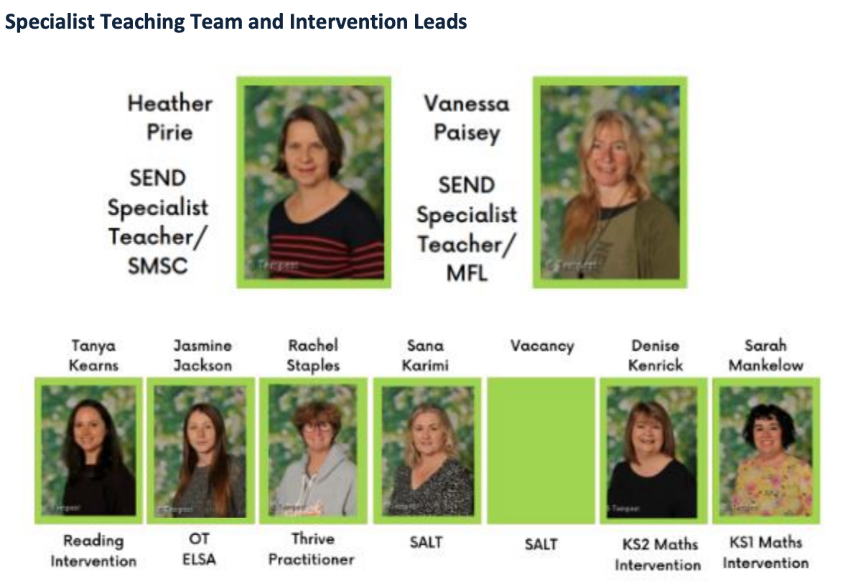
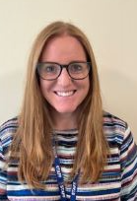
Specialist team
Class Teachers
All of our teachers receive in-house SEN training, and are supported by the SENCO to meet the needs of pupils who have SEN. Specialist Teaching Team and Intervention Leads
Suzi
Austin

Slide 7
External Agencies
Sometimes we need extra help to offer our pupils the support that they need. Whenever necessary we will work with external support services to meet the needs of our pupils with SEN and to support their families. These include:
●STIP (Specialist Teachers for Inclusive Practice)
●Woodlands Autism Outreach
●Speech and language therapists
●Educational psychologists
●Occupational therapists
●GPs or paediatricians
●School nurses
●Child and adolescent mental health services (CAMHS)
●Mindworks
●Education welfare officers
●Social services and other LA-provided support services
●Voluntary sector organisations
We aim to ensure that all staff working with children who have SEND possess a working knowledge of their individual needs to help them in supporting access to the curriculum. Where it is deemed that external support is necessary, we discuss any referrals with parents, in the first instance.

Slide 8
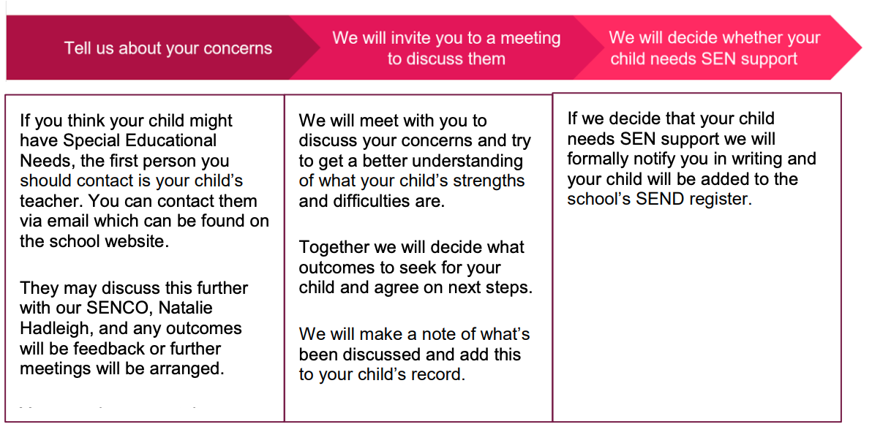
What should I do if I think my child has SEN?
The school has an SEN policy which can be found on the school website at: https://www.lingfieldprimaryschool.com/

Slide 9
How will the school know if my child needs SEN support?
● The school has a SEND Policy which can found on the school website at: Lingfield Primary School
● The school SENCO is Natalie Hadleigh: nhadeigh@lingfield.surrey.sch.uk
● The school phone number is 01342 832626
● The progress of all pupils is monitored regularly by class teachers and the Leadership Team so that when a pupil is not making progress in a particular area of learning the school can identify the need for additional support.

Slide 10
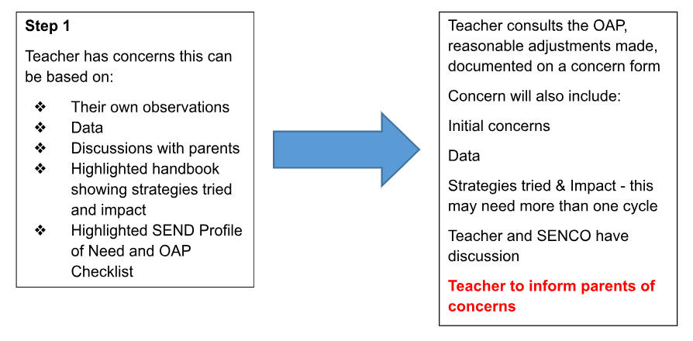
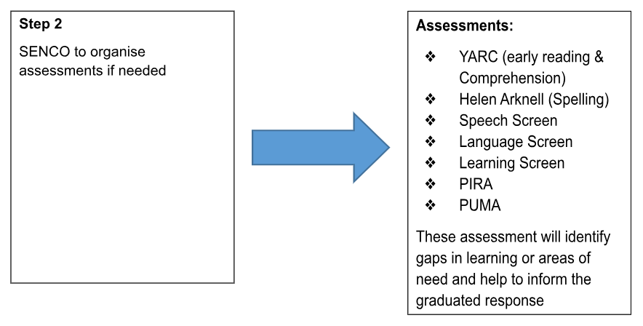
Flowchart for Graduated Approach

Slide 11
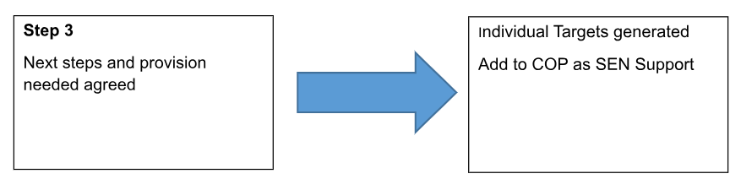
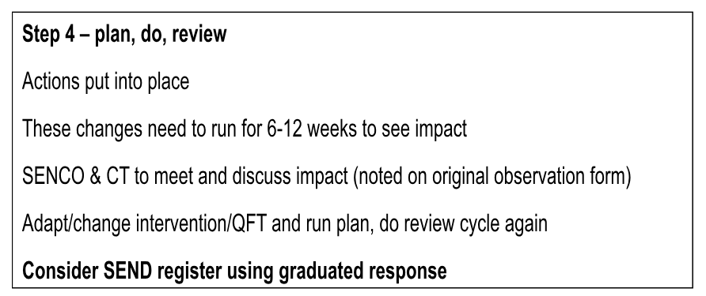
Flowchart for Graduated Approach

Slide 12
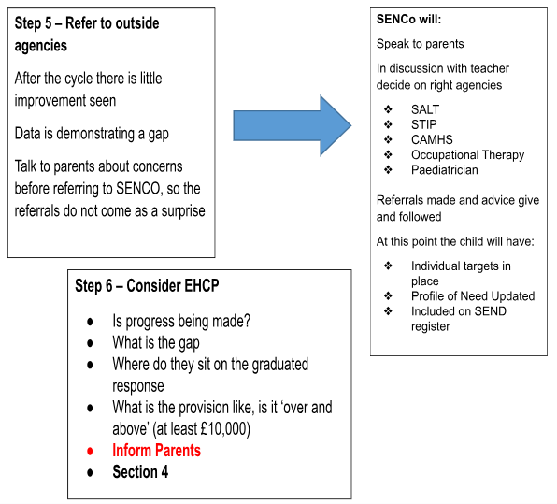
Flowchart for Graduated Approach

Slide 13
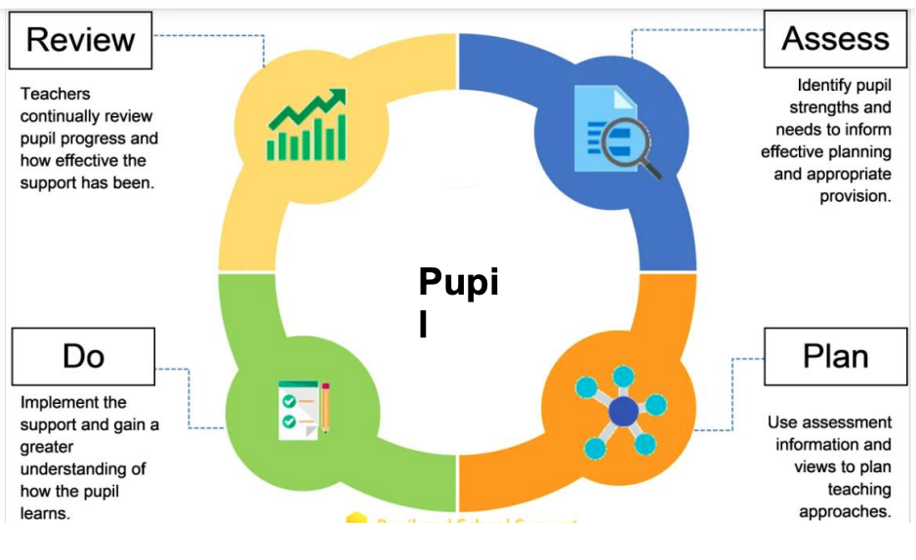

How will the school measure my child’s progress?
During our assess, plan, do and review cycle, we will look at the actions needed to support children to work towards their outcomes and highlight what each person involved can do in order to make a positive contribution. Staff are available at the end of the day to talk about any issues or make appointments to discuss concerns in more detail. Appointments to speak to the class teacher, the phase group leader, the SENCO or another member of the leadership team can also be made via the school office (01342 832626;info@lingfield.surrey.sch.uk). Parents/carers are involved in referrals and invited to meet with outside professionals; children are also included in this consultation process in order to establish their views about their learning. To find out more about the graduated response please visit the Surrey Local Offer website: Surrey Local Offer

Slide 14
How will I be involved in decisions made about my child’s education?
We provide a range of opportunities for parents/carers to come into school and staff are available at the end of the day to talk about any issues or make appointments to discuss concerns in more detail.
● Parents/carers of new Reception children are invited to a meeting at the end of the summer term prior to the children starting to meet the staff and share information about the school. The SENCO is available at these meetings to discuss any particular concerns regarding children with SEND
● At the beginning of the new school year, Nursery and Reception parents have the opportunity of a home visit. The SENCO may attend if necessary
● Parents of new Nursery children also have the opportunity to visit with their children to support their transition into the setting. The SENCO is available at this time to discuss any particular concerns regarding children with SEND.
At the start of the school year, a ‘Meet the Teacher’ session is arranged for Year 1- Year 6. Parents/carers are invited to meet their child’s class teacher. Here the expectations for the year are explained as well as sharing the curriculum coverage.
● Formal parent consultation meetings are held every term and progress reports are shared in the summer term as part of this consultation.
● Appointments can be made to meet with teachers after the progress reports have been sent home. These meetings will: Set clear outcomes for your child’s progress
Review progress towards those outcomes
Discuss the support we will put in place to help your child make that progress
Identify what we will do, what we will ask you to do, and what we will ask your child to do
The SENCO may also attend these meetings to provide extra support

Slide 15
How will I be involved in decisions made about my child’s education?
● If your child is on the SEN Code of Practice, they will have personalised Individual Targets detailing the provision in place to support them; these will be reviewed and shared termly.
● We provide a range of further opportunities for parents/carers to come into school including sessions to guide parents in supporting their children’s learning at home, e.g. open classrooms and information sessions
We also share information with parents on how to help their child at parents’ evenings and where necessary through homework set.
● Parents/carers, as well as extended family members, are encouraged to volunteer in the school. Volunteers currently help with activities such as reading, swimming sessions and school trips.
● We have an active parent group (Lingfield Primary School Association – LPSA) who plan and run a wide range of activities and events and all parents are automatically members. Contact info@lingfield.surrey.sch.uk if you are keen to get involved.
● We have parent governors who can take an active role in the overall strategic direction of the school including: financial management, curriculum development and whole school improvement. Further information about the role of school governors is available on the school website (www.lingfieldprimaryschool.com) and they can be contacted via the school office (01342 832626) or via the Governors’ post pox in the main office entrance. Our Chair of governors, Mr Cameron Turner, can be contacted directly via email cturnergov@lingfield.surrey.sch.uk).
● Parents/carers have the opportunity to voice their views through the annual parent questionnaire as well as directly with the school.
● Parents attend Annual Reviews of their child’s EHCP
● Half-termly parents drop-ins are held around special educational needs

Slide 16
How will my child be involved in decisions made about their education?
Decisions about what type and how much support your child will receive are made through teacher assessment supported by progress and attainment information. Where outside agencies are involved, advice on support will also be taken into account.
The SENCO and Leadership Team will support teachers through individual review meetings and pupil progress meetings.
Discussions about what type and how much support will be received take place with parents/carers at consultation meetings and annual EHCP (Education, Health and Care Plan) review meetings.
One page profiles are produced in consultation with children with an EHCP so that teaching staff have a clear overview of the whole child. We feel that it is important to have the views of the learner so that they feel involved in their own learning.

Slide 17
How will the school adapt its teaching for my child?
Your child’s teacher is responsible and accountable for the progress and development of all the pupils in their class. All teachers have information on the needs of individual pupils so they can plan learning within our curriculum to ensure that everyone is able to make progress. This includes extending our highest-attaining children to ensure they achieve mastery.
High-quality teaching is our first step in responding to your child’s needs. We will make sure that your child has access to a broad and balanced curriculum in every year they are at our school. Some children receive additional support by accessing small group interventions and booster sessions outside of their classroom and others access small bespoke learning groups for core subjects. In addition to this, we provide the following in house interventions:
● ELSA
● Occupational Therapy
● Speech and Language
● Social Communication
● Thrive
● Better Reading Partnership (BRP)
● Attention Autism Bucket
● Early Talk Boost
We will make reasonable adjustments or use adaptive teaching techniques to suit the way the pupil works best. These reasonable adjustments are personalised to make sure the adaptations we make are meaningful to your child. Examples of some of the reasonable adjustments that may be made can be found in the Surrey Ordinarily Available Provision Document (Ordinarily available provision (schools) | Surrey Local Offer). In addition to this at Lingfield Primary School we offer the following:

Slide 18
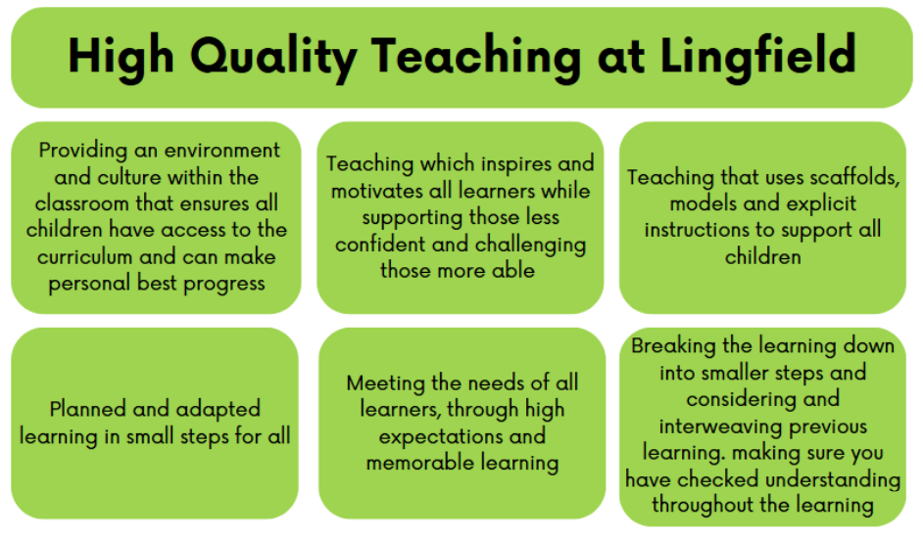
High Quality Teaching at Lingfield

Slide 19
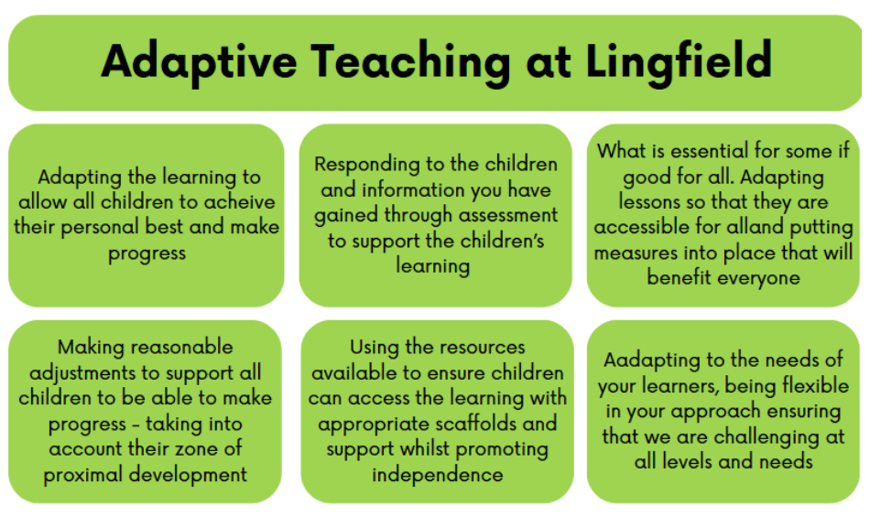
Adaptive Teaching at Lingfield

Slide 20
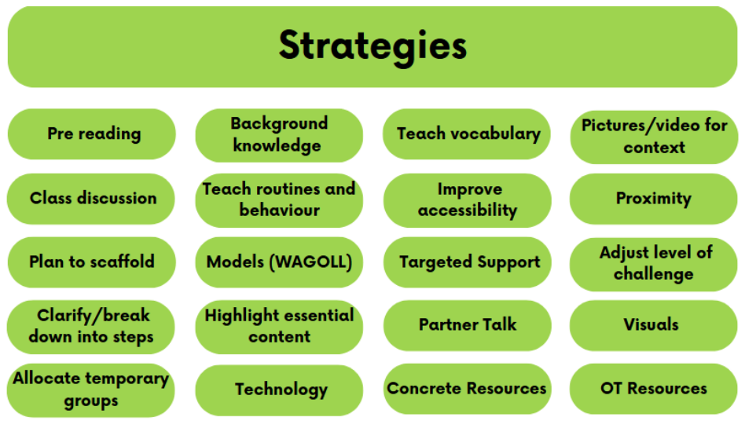
Strategies
We have an Accessibility Plan in place which shows how adaptations are made not only to the built environment but to the curriculum and how information is accessed by children and their parents. The school is committed to ensure access for adults and children through reasonable adaptations of the physical environment, e.g. sound field systems in the hall and gym, wheelchair access to all areas of the ground floor, disabled parking bays. We accommodate additional needs individually as part of our Inclusion and Equality policies

Slide 21
How will the school evaluate whether the support in place is helping my child?
We will evaluate the effectiveness of provision for your child by:
● Reviewing their progress towards their goals each term
● Reviewing the impact of interventions after a set number of weeks
● Regular Learning Walks to review how provision is delivered and help in maintaining standards through rigorous quality assurance
● Governor Learning Walks to review provision
● Monitoring by the SENCO
● Using provision maps to measure progress
● The progress and attainment of all pupils is monitored by class teachers, the SENCO and the Leadership Team. Additional support and interventions are discussed at termly pupil progress meetings to ensure these are matched to needs. Our provision management looks at the impact of each intervention on children’s progress
● Holding an annual review (if they have an education, health and care (EHC) plan) ● Each year we review the needs of the whole cohort to see if there is a change in the overall make-up of the cohort. Decisions are then made as to whether any additional interventions need to be put in place e.g. mixing classes

Slide 22
How will the school resources be secured for my child?
Finances are monitored regularly by the Headteacher, Governors and School Business Manager
We seek to ensure a value for money service, so all interventions are costed and evaluated so we can assess how effective they are. Our budget is allocated according to our Provision Management system.
Governors are strategically involved in budget setting and monitoring
Where specific resources are needed for children, we allocate funds from our SEN budget or from specialist support services.
Children whose needs cannot be met through the school’s own resources will go through a process to be assessed for an Education, Health and Care Plan (EHCP). Should an EHCP be granted by the local authority, additional resources and support may be provided. On occasion, this could include a recommendation for Specialist Provision.

Slide 23
How will the school make sure my child is included in activities alongside pupils who don’t have SEND?
We have a whole school approach to inclusion which supports all children engaging in activities together. We plan to make sure that all clubs, trips and visits include all pupils and, where reasonable, provide additional support for individual children where necessary. We discuss any concerns and difficulties around clubs, activities and trips with parents/carers and work together to provide support, including financial assistance. Registers are taken for all school activities and we actively monitor the engagement of children across the school.

Slide 24
How does the school make sure the admissions process is fair for pupils with SEN or a disability?
Surrey County Council is the admission authority for this school. To find up to date information about the school's admission arrangements and details on how to apply, either as part of the normal intake or during the school year, please use this link: School admissions - Surrey County Council (surreycc.gov.uk)

Slide 25
How does the school support pupils with disabilities?
We have an Accessibility Plan in place and all our staff are fully aware of the requirements of the Equality Act (2010), ensuring that policy and practice follow those requirements
We are vigilant about making reasonable adjustments where possible. Our policy and practice follows the Equality Act 2010
The school is a two-storey building, there is currently no step free access to the first floor but the ground floor is fully accessible. There are ramps on some external doors that may have a slope
There are disabled toilets for children and adults which are wheelchair accessible
We work closely with outside agencies and are led by their advice on supporting a variety of disabilities

Slide 26
How will the school support my child’s mental health and emotional and social development?
We provide support for pupils to progress in their emotional and social development in the following ways:
● Pupils with SEN are encouraged to be part of the school council and take a position of responsibility in Year 6. There is strong representation of children from all parts of our school community.
● We provide a high standard of pastoral support, which we believe to be a strength of the school, for all of our children and families
● We have a trained ELSA specialist and Thrive practitioner and adopt the Thrive approach across the school. Our specialists provide targeted support for individuals and small groups of children with emotional needs
● We have a robust approach to bullying in the school which is outlined in the behaviour policy
● Our PSHE programme looks to develop emotional and social development. In the first instance, every child has a class teacher who they can talk to in order to share any concerns
● We regularly monitor attendance and take the necessary action to prevent prolonged unauthorised absence
● Pupil voice is central to our ethos and this is encouraged in a variety of ways, specifically via the school council and pupil surveys
● Our Behaviour Policy, which includes guidance on expectations and values, is fully understood and implemented by all staff. We regularly monitor behaviour and put in place strategies to support individual children
● Identified staff are trained to support specific medical needs, as necessary, and all staff have first aid training. We have a medical policy and clear systems in place.

Slide 27
What support will be available for my child as they transition between classes or settings or in preparing for adulthood?
Between years
To help pupils with SEND be prepared for a new school year we:
● Ask both the current teacher and the next year’s teacher to hold transition meetings when the pupil’s SEN and reasonable adjustments in place are discussed
● Schedule lessons with the incoming teacher towards the end of the summer term
Joining our School
We offer home visits and parents/carers meetings for children joining Reception and Nursery
● Run taster sessions to support their transition
● If the children have attended other nurseries staff will make contact to share information as appropriate
● In year applications are offered a school tour and meet new staff they may be working with
● Buddies are offered to support in the first few days
● Relevant information from parents/carers and previous schools and nurseries is shared with staff so that appropriate support can be put in place as quickly as possible.
Between schools
● School records are received or passed on to new schools including information relating to any special educational needs or additional support
● Our SENCO may contact previous or receiving schools to gain or pass on specific information where appropriate.

Slide 28
What support will be available for my child as they transition between classes or settings or in preparing for adulthood?
Between phases
● Secondary school staff visit our school to speak to staff and children during the summer term. Information and best practice is shared between the junior and secondary staff
● In some cases, staff from the receiving secondary schools come in to work with individuals or small groups to give them a familiar face for when they transfer
● Visits to the local secondary school are also organised and we fully encourage all our children to attend induction days.
● Outside agencies, such as STIP, may offer extended transition support for specific pupils
● Parents are supported through the process of choosing the next stage of their child’s education. Guidance and signposting for advice is given so that everyone involved can take an active part in preparing for these next steps. Advice and support is also received for specific children from outside agencies such as Traveller Education and Woodlands Outreach

Slide 29
What support is in place for looked-after and previously looked-after children with SEN?
Andrew Winter (DSL) is our Designated Teacher. He will work with Natalie Hadleigh (SENCO) to make sure that all teachers understand how a looked-after or previously looked-after pupil’s circumstances and their SEN might interact, and what the implications are for teaching and learning.
Children who are looked-after or previously looked-after will be supported much in the same way as any other child who has SEND. However, looked-after pupils will also have a personal education plan (PEP). We will make sure that the PEP and any SEN support plans or EHC plans are consistent and complement one another.

Slide 30
What should I do if I have a complaint about my child’s SEN support?
● For parents/carers who have concerns about their child the first point of contact is the class teacher, either directly or via the school office
● If parents/carers continue to have concerns, our SENCO or the phase group leaders are available to discuss worries about children’s progress and special educational needs or disability
● Outside agencies involved with individual children can also be contacted through the school
● Our Headteacher and leadership team are available to discuss what we can offer and answer questions
● Our SEND Governor is James Kearns: jkearnsgov@lingfield.surrey.sch.uk
● A copy of the school's complaints procedure can be found on the school website (www.lingfieldprimaryschool.com). The complaints procedure will outline the formal steps the school will take in handling each complaint
● Where a resolution between the parent and school cannot be reached, parents will be advised to seek external support through the Surrey County Council Area Schools Officer or the Department for Education

Slide 31
What support is available for me and my family?
If you have questions about SEND, or are struggling to cope, please get in touch to let us know. We want to support you, your child and your family. To see what support is available to you locally, have a look at Surrey’s local offer. Surrey County Council publishes information about the local offer on their website: https://www.surreylocaloffer.org.uk/
Our local special educational needs and disabilities information advice and support services (SENDIASS) organisations are:
Surrey
SEND Advice Surrey National charities that offer information and support to families of children with SEND are:
●IPSEA
●SEND family support
●NSPCC
●Family Action
●Special Needs Jungle
Local charities that offer information and support to families of children with SEND are:
●NAS Surrey Branch
●Tandridge Family Centre : Surrey Barnardos Family Centres

Slide 32
Glossary
Access arrangements – special arrangements to allow pupils with SEND to access assessments or exams
Annual review – an annual meeting to review the provision in a pupil’s EHC plan
Area of need – the 4 areas of need describe different types of needs a pupil with SEND can have. The 4 areas are communication and interaction; cognition and learning; physical and/or sensory; and social, emotional and mental health needs.
CAMHS – child and adolescent mental health services
Differentiation/ Adaptive Teaching – when teachers adapt how they teach in response to a pupil’s needs
EHC needs assessment (EHCNA) – the needs assessment is the first step on the way to securing an EHC plan. The local authority will do an assessment to decide whether a child needs an EHC plan.

Slide 33
Glossary
EHC plan (EHCP) – an education, health and care plan is a legally-binding document that sets out a child’s needs and the provision that will be put in place to meet their needs.
First-tier tribunal/SEND tribunal – a court where you can appeal against the local authority’s decisions about EHC needs assessments or plans and against discrimination by a school or local authority due to SEND
Graduated approach – an approach to providing SEN support in which the school provides support in successive cycles of assessing the pupil’s needs, planning the provision, implementing the plan, and reviewing the impact of the action on the pupil
Intervention – a short-term, targeted approach to teaching a pupil with a specific outcome in mind
Local offer – information provided by the local authority which explains what services and support are on offer for pupils with SEN in the local area
Outcome – target for improvement for pupils with SEND

Slide 34
Glossary
Reasonable adjustments – changes that the school must make to remove or reduce any disadvantages caused by a child’s disability
SENCO – the special educational needs co-ordinator
SEN – special educational needs
SEND – special educational needs and disabilities
SEND Code of Practice – the statutory guidance that schools must follow to support children with SEND
SEN information report – a report that schools must publish on their website, that explains how the school supports pupils with SEN
SEN support – special educational provision which meets the needs of pupils with SEN
Transition – when a pupil moves between years, phases, schools or institutions or life stages

