Slide 1
Puberty
An overview

Slide 2
What is puberty?
Puberty is the time when your body changes from being a child to a young adult.
Your body is preparing itself to be able to reproduce (have a baby).

Slide 3
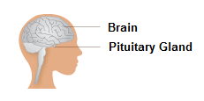
Why does it happen?
Puberty starts when extra amounts of chemicals called hormones start to be produced in the body.
The body produces the sex hormones OESTROGEN, PROGESTOGEN and TESTOSTORONE which are responsible for many different changes in the body.
The brain and pituitary gland release the hormones that regulate the reproductive
organs.

Slide 4
What changes happen to girls?
Get taller and heavier
Bones grow bigger and heavier
Hips get wider and more curvy
Face changes shape
Voice gets a little deeper
Hair grows under the armpits, around the genitals (pubic hair)
Hair on arms and legs grows darker
Breasts and nipples get larger
Body sweats more
Internal and external sex organs grow
May have mood swings

Slide 5
What changes happen to boys?
Get taller and heavier
Bones grow bigger and heavier
Chest broadens, shoulders widen
Face changes shape
Voice gets deeper
Hair grows under the armpits, around the genitals (pubic hair)
Hair on arms and legs grows darker
Hair grows on chest
Facial hair grows
Body sweats more
External sex organs grow

Slide 6

Girls

Slide 7
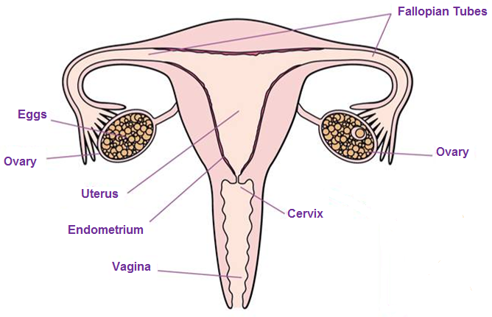
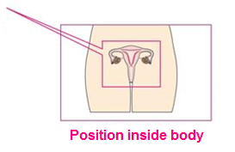
Female Reproductive System

Slide 8
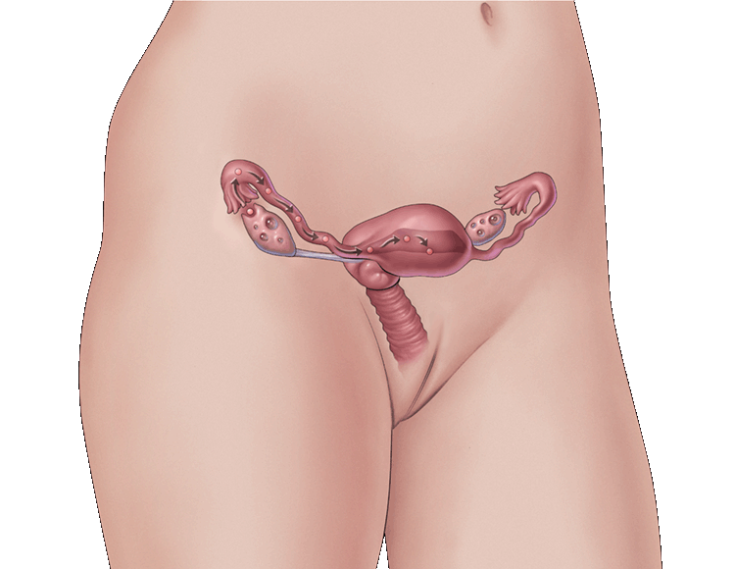
What are periods?
Periods (menstruation) happen due to the hormones changing in your body.
Even before birth, a girl has 1-2 million tiny eggs (Ovum) in her ovaries. When puberty is reached an egg is released each month from her ovaries.
The egg moves from the ovary and along the fallopian tube and down into the (womb) uterus.
If the egg is not fertilised by a sperm then the lining of the uterus and the egg leave your body through your vagina; this is your period.

Slide 9
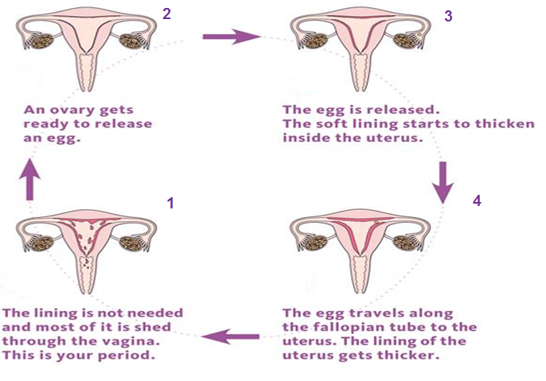
The Menstrual Cycle

Slide 10
What are periods?
Bleeding can last between 3 and 8 days.
Blood flow may be heavier in the first few days.
The average blood loss is only around 80ml
(roughly 3 tablespoons).
Periods happen once a month but your body takes time do get into a routine so for the first year or so the time between each period may vary.

Slide 11
How might you feel?
Many girls will feel PMS (premenstrual syndrome),
symptoms can include:
Tender breasts
Headaches
Mood swings
Stomach cramps
Feeling bloated
Tiredness
Spots
Food cravings
Difficulty concentrating

Slide 12

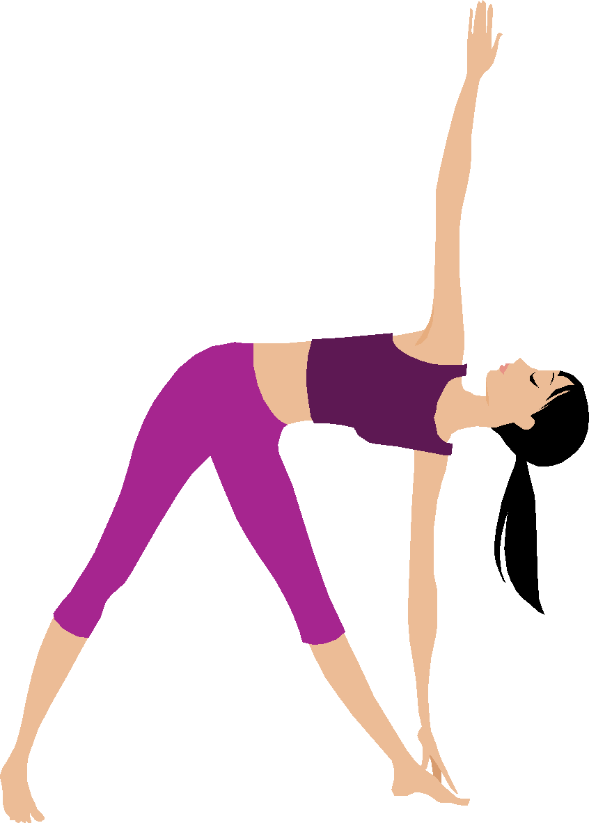

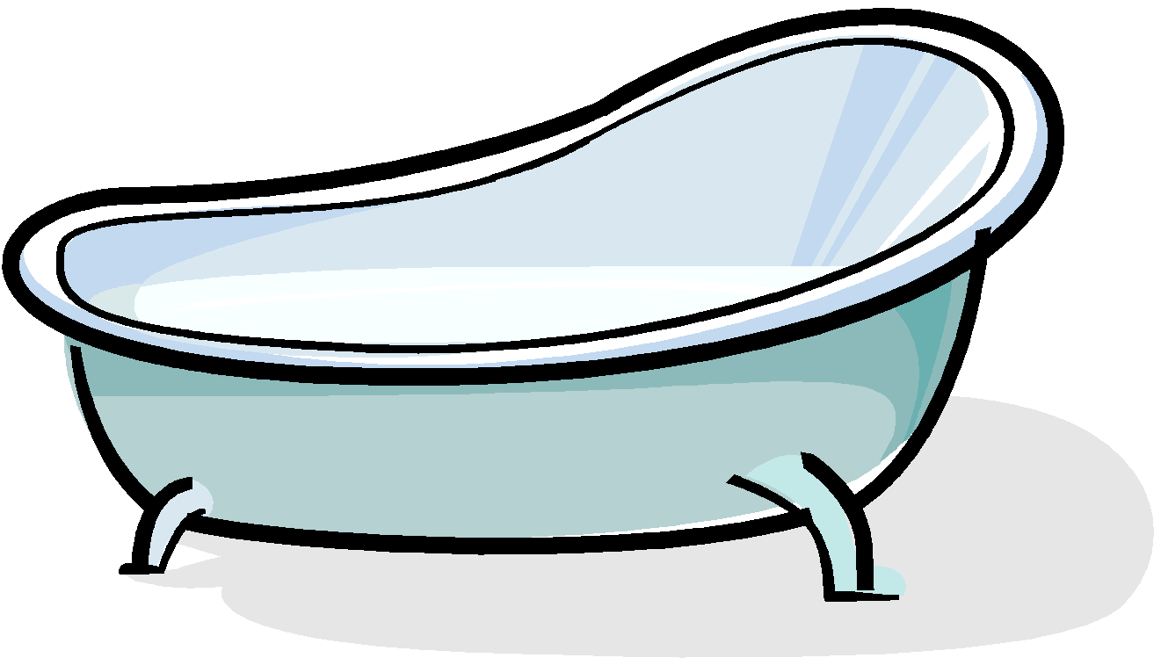
What might help?
Have a warm bath
Massage your stomach
Have a nice warm drink
Use a hot water bottle or use a heat pad.
Eat a well balanced diet.
Exercise

Slide 13
What might help?
There are different types of protection you can use
during your period to absorb your period to stop it getting on to your clothes/underwear.
The choice is a personal choice and different for
each girl.
1. Sanitary Towels
2. Tampons

Slide 14
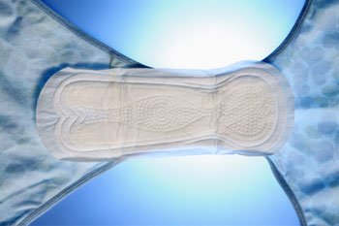
What are sanitary towels?
Worn outside your body, in your underwear.
Many different absorbencies.
Wings provide extra protection.
Change frequently to keep fresh and dry (generally every 4-6 hours, more often when your period is heavy).
They will start to leak if you don’t change them!

Slide 15
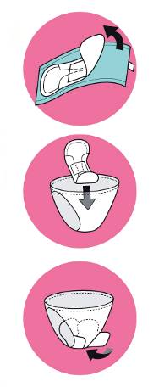
What are sanitary towels?
1. Pull off paper strip or wrapper.
2. Attach sticky part securely to center of underwear.
3. For wings, peel off paper strips and wrap around sides of underwear.

Slide 16
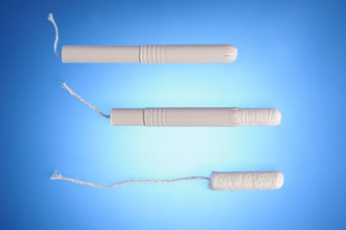
What are tampons?
Worn inside your body in your vagina to absorb menstrual flow.
Different range of absorbencies.
Good for swimming and gymnastics.
Should be changed regularly (every 4-8 hours, more often when your period is heavy).

Slide 17
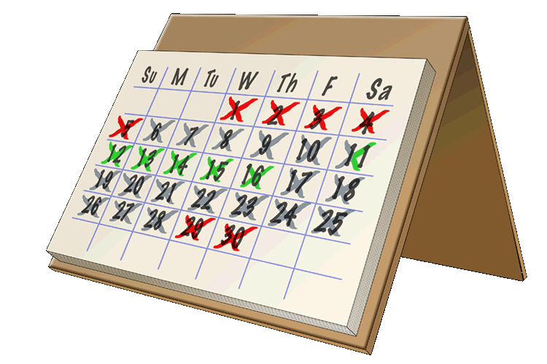
Managing periods
Mark on a calendar the date of your
first period.
Count 28 days from the day of your
FIRST blood show, this will give you a rough idea of when your next period will be.
Always carry some spare knickers and sanitary towels in your bag.
REMEMBER periods will not have a set pattern in the beginning, they will eventually settle into their own pattern.

Slide 18

Boys

Slide 19
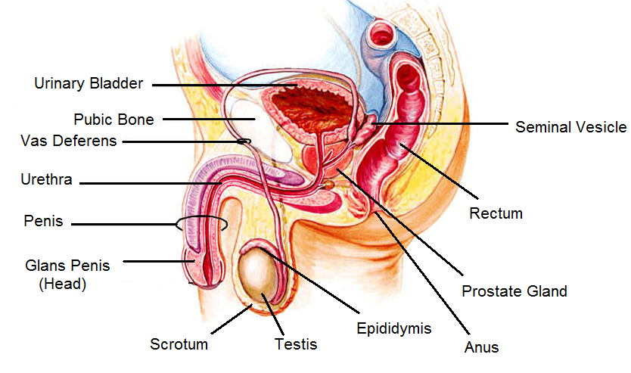
Male Reproductive System

Slide 20
Male Reproductive System
The reason boys have a reproductive system is because it provides the sperm needed to fertilize a female’s egg, which can then develop into a baby.
During puberty the levels of the hormone testosterone in your body begin to rise. This causes the penis and testicles to get bigger and the testicles to produce sperm.
The testicles cannot make sperm before puberty.
Sperm look like tadpoles, with what appear to be a head and a tail.

Slide 21
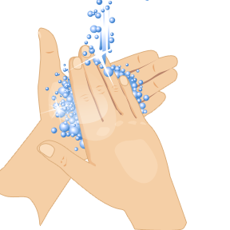
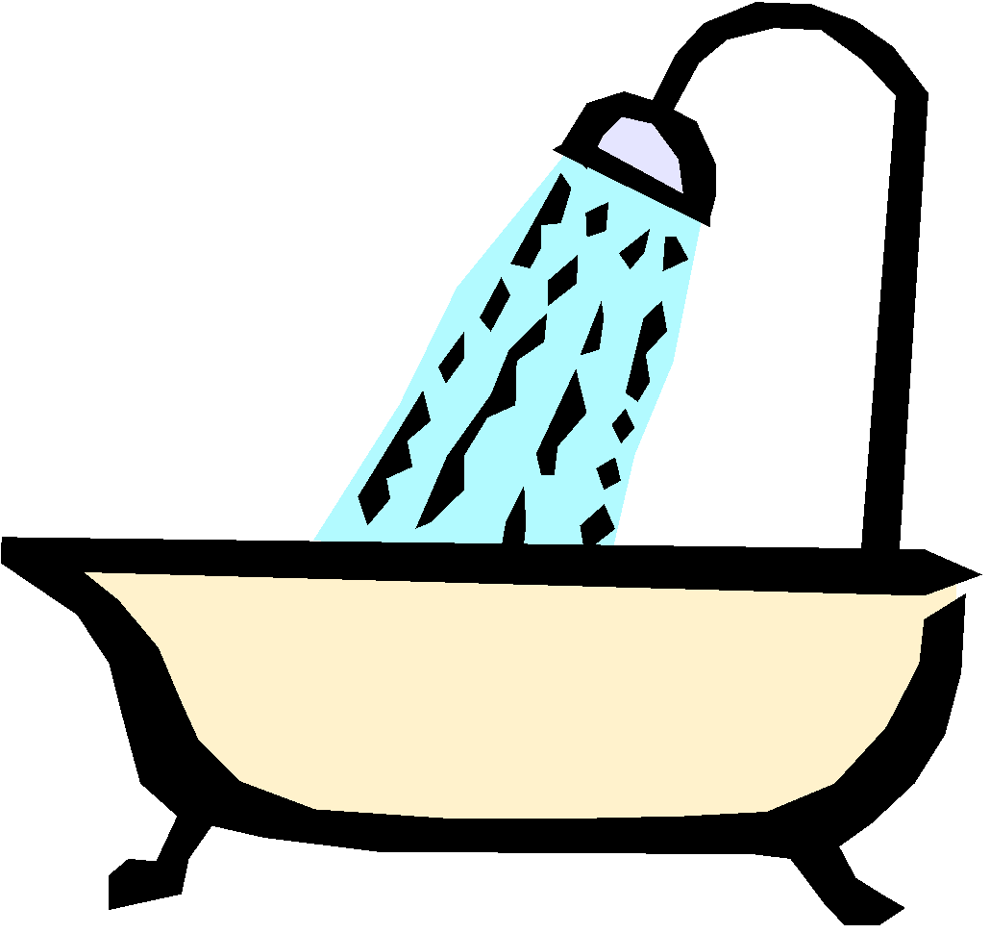
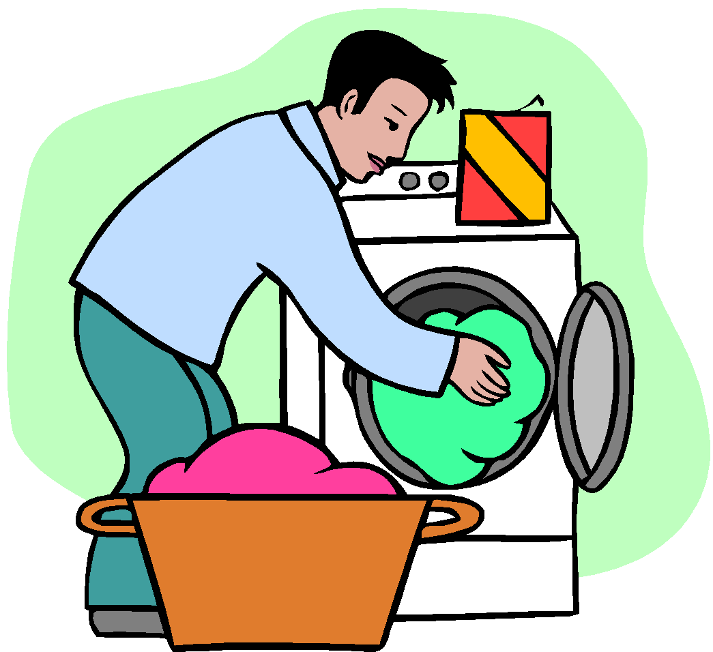
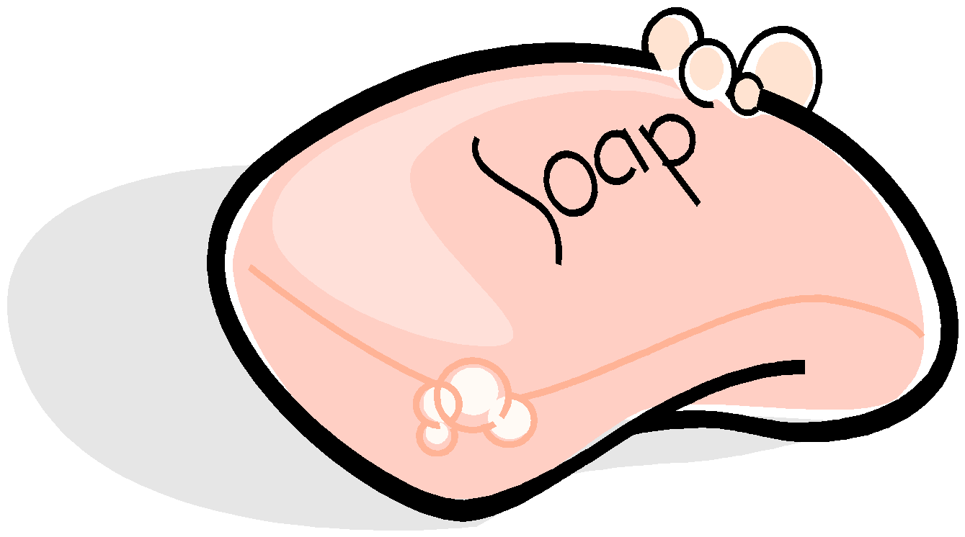
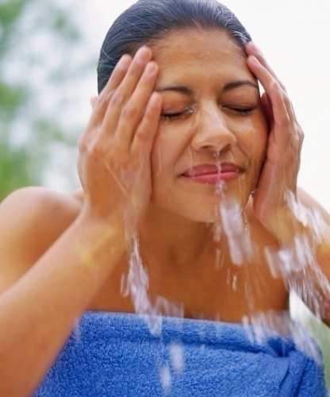
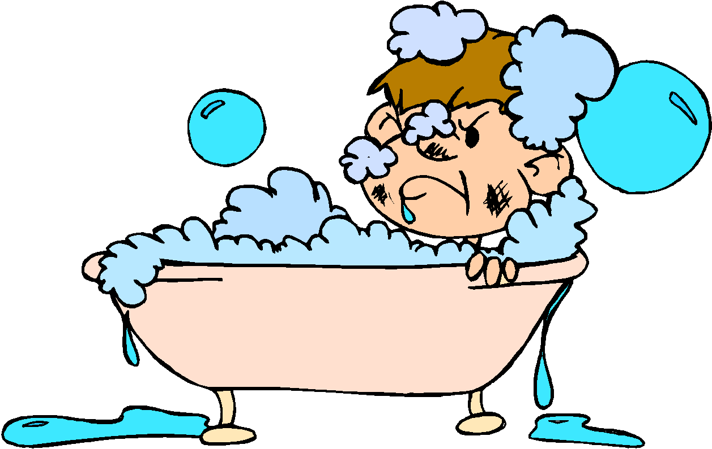
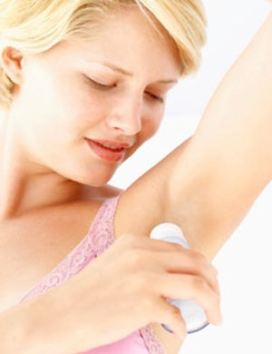
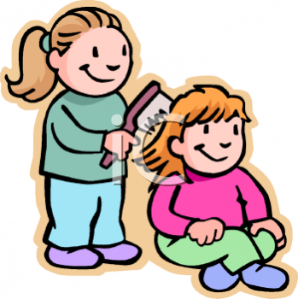
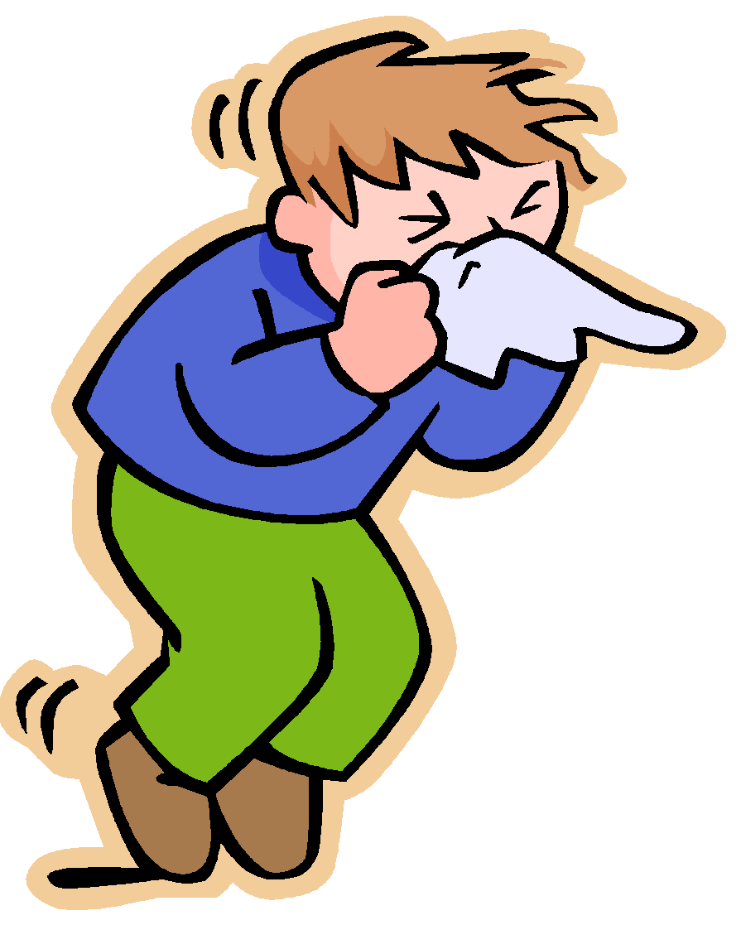

Personal Hygiene

Slide 22

Why do we sweat?
Sweat is your body’s natural way of helping you to cool down.
Sweat can also sometimes become smelly when the chemicals it contains mixes with bacteria that live naturally on your skin.

Slide 23

Any questions?

